Slide 1

Citizen watch
911 SERVICES

Slide 2
CITIZEN WATCH
HOSPITAL DEPARTMENT
SAPS
DEPARTMENT
FIRE-FIGHTING
DEPARTMENT

Slide 3
SYSTEM OVERVIEW
Citizen Watch is an embedded application that consist of both software and hardware. It is an application designed from the initiative of safety and an experience I once encountered. As many says and know that most of us females, we very bad when it comes to giving directions, it becomes much worse when we are under pressure or frightened and that goes even for everyone. Am originally from the Eastern Cape which is -- kilometers from Pretoria. Two years back on my way home{Eastern Cape} I came across a terrifying car accident on the R57 road most people lost their lives because ambulances took so much time to arrive and that being caused by being given wrong directions of the incident. If they came in time, they could have saved most lives, that’s how the idea of Citizen Watch came about.

Slide 4
SYSTEM OVERVIEW
It is every Citizen right to be in good health and well-being, so if any citizen comes across any emergency set-up or condition, they should be able to report that incident using their correct location co-ordinates, simply by using Citizen Watch application. For testing purposes, I will be using a Bluetooth module for communication between the mobile application and the Arduino hardware application, which is a 911 emergency Departments represented by an LCD for displaying location co-ordinates of the incident, a 4 digit 7- segment that will display the word “HELP” for the 911 emergency Department Administrator to know there’s a citizen seeking help at the location co-ordinates displayed on the LCD, and 2 LED’s: Red & blue. The red LED will blink to catch the Administrators attention when an emergency is being reported.

Slide 5
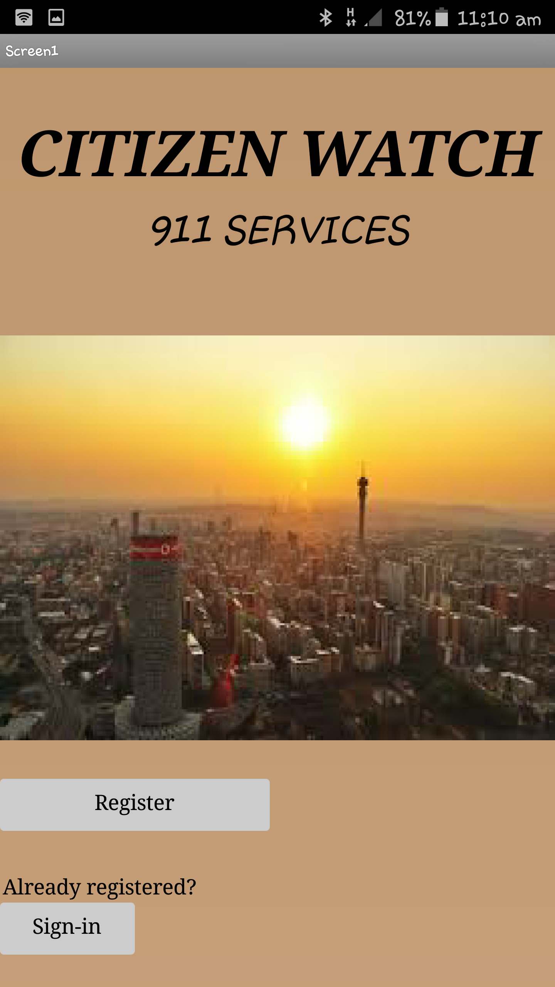
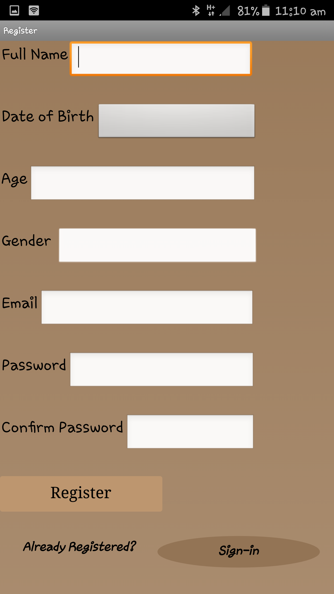
MOBILE APPLICATION

Slide 6
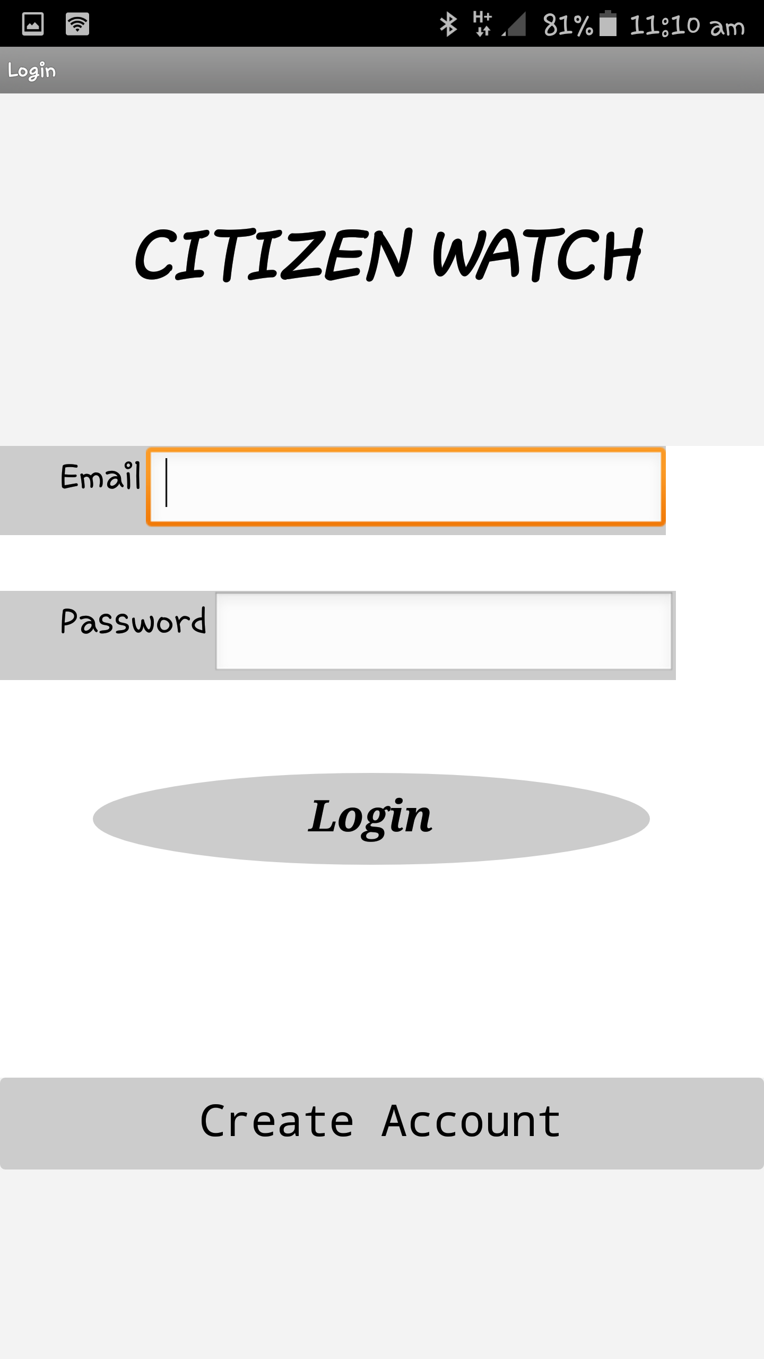
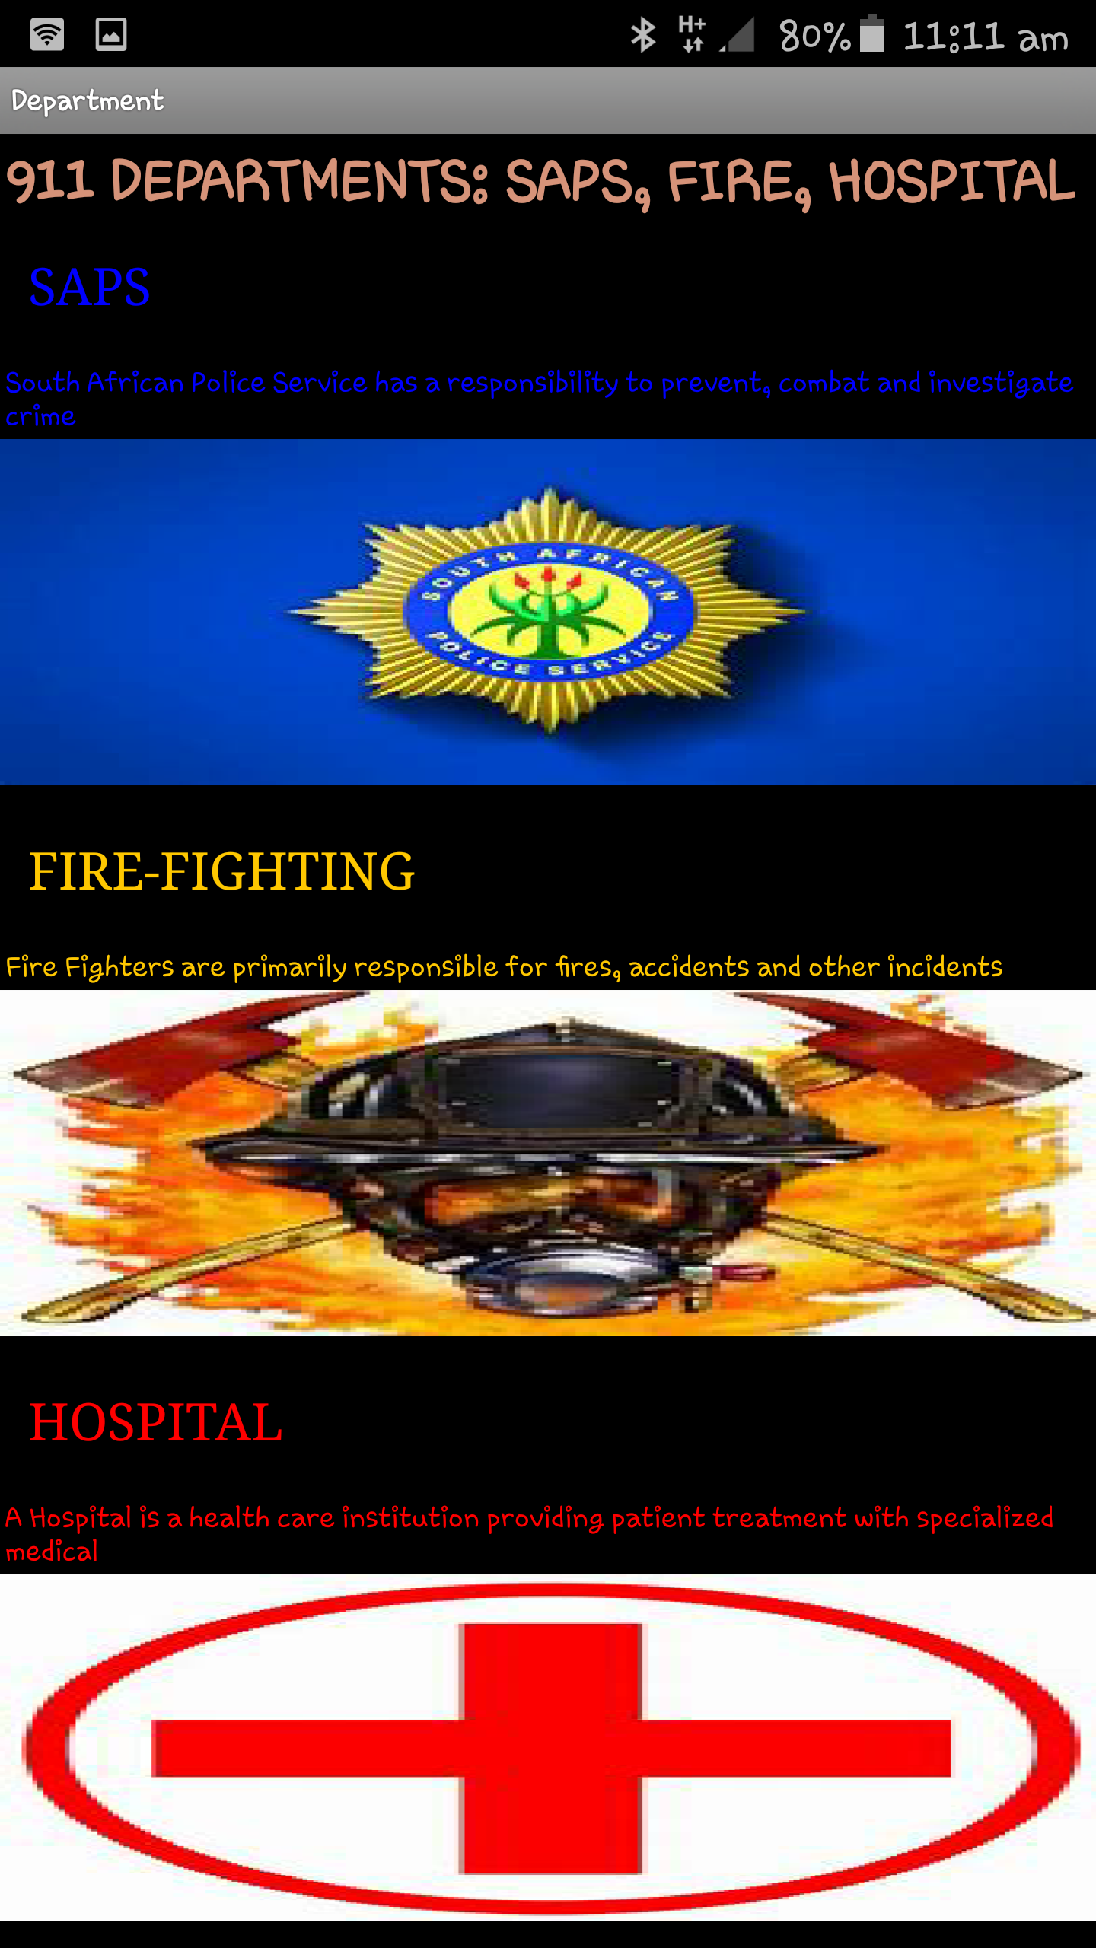

Slide 7
